Slide 1
UMD Baseball Insights
Presentation Date:
12/06/2023
Terps Business Solutions
Henry Liu
Alireza Bavafa
Chandan Nelamangala Arun Kumar
Aagney Menon
Last Revised 12/07/2023

Slide 2

Background
Users
UMD baseball team
Analysts
https://umterps.com/sports/baseball/schedule
Data Source

Slide 3
Introduction
A boutique consultancy specializing in data analytics
We Are
Terps Business Solutions
To provide actionable insights to the Maryland Baseball team by identifying key strengths and weaknesses based on historical data
Our Mission

Slide 4
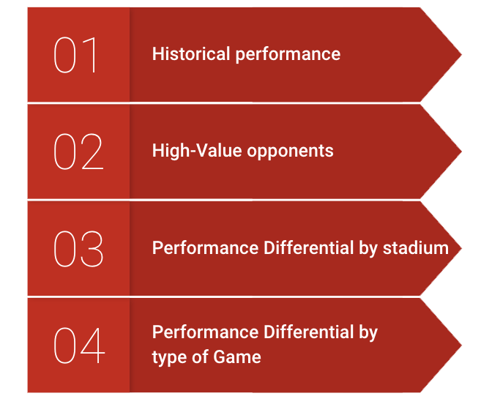
Mission Objectives
Notes:
<a href="https://storyset.com/user">User illustrations by Storyset</a>

Slide 5
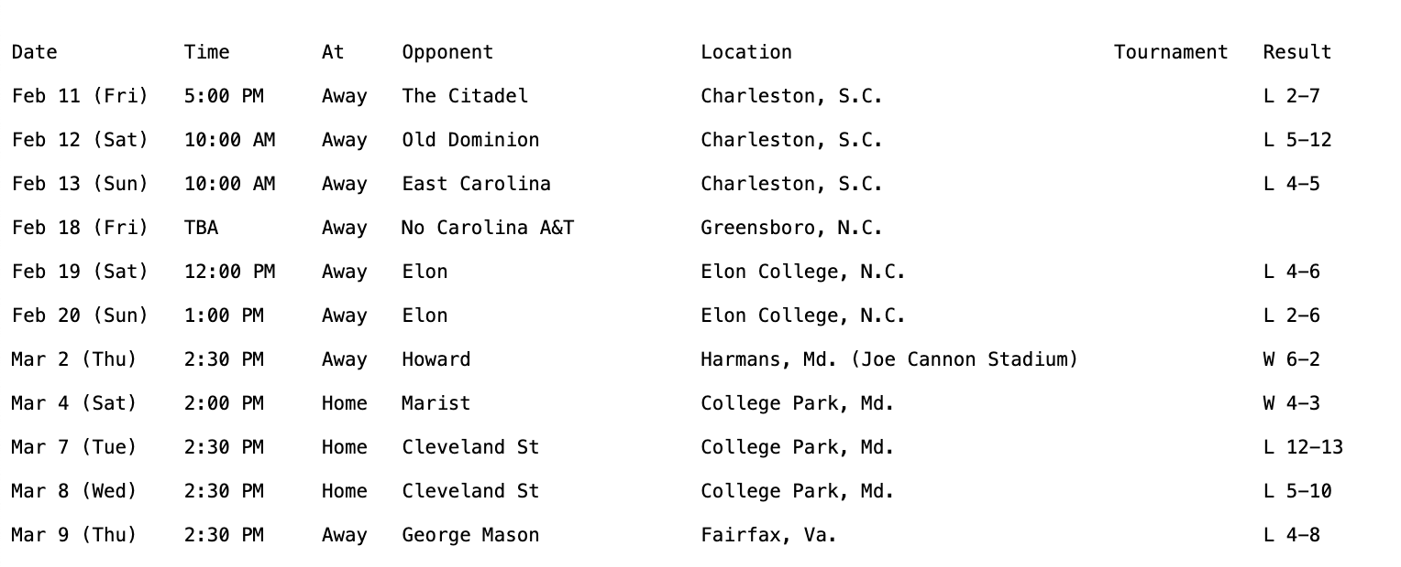
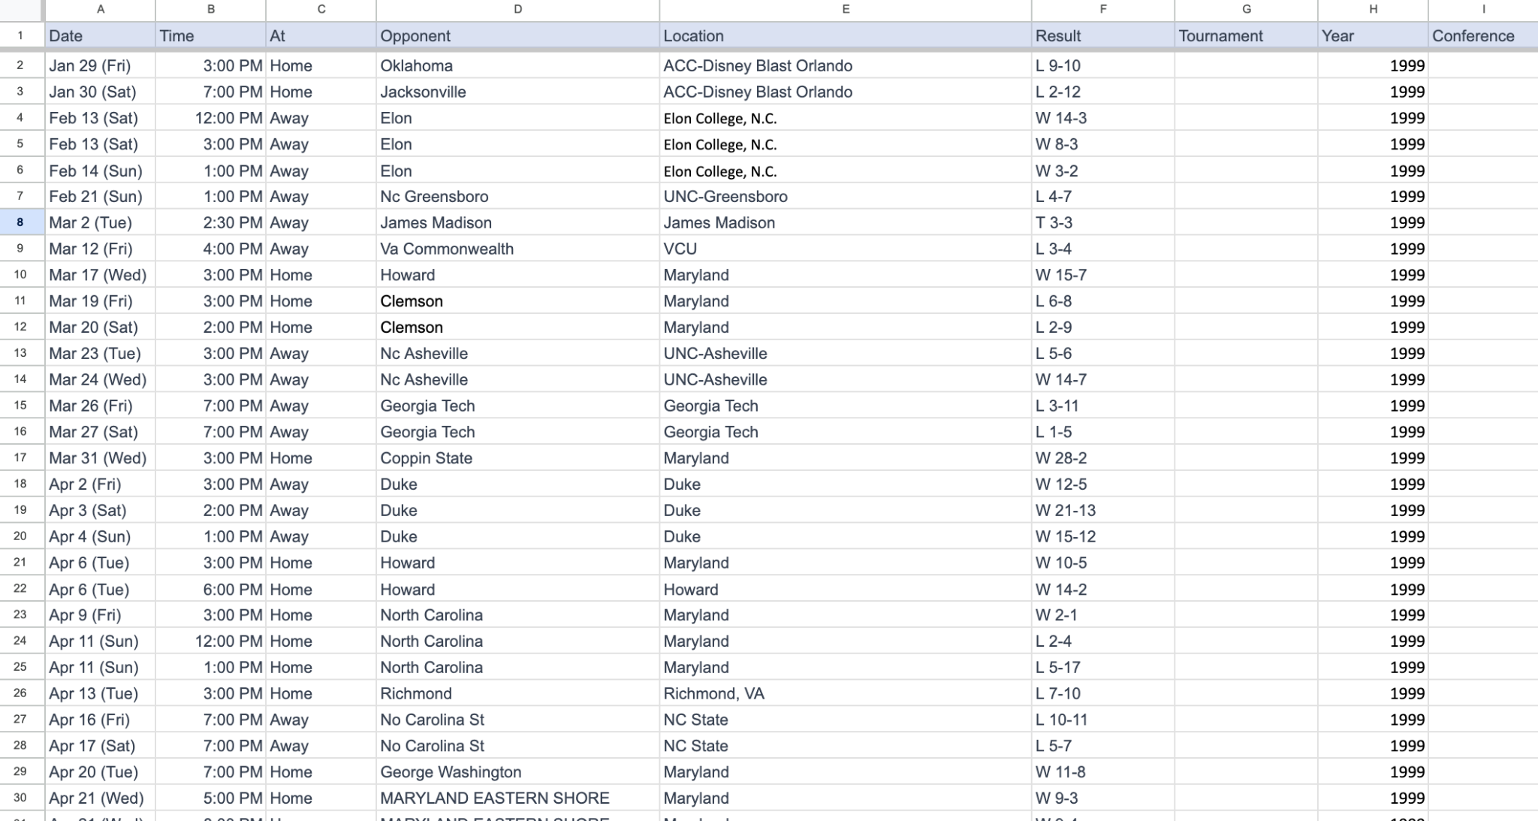



Our Approach
Data Collection
Data Cleaning
Data Analysis

Slide 6
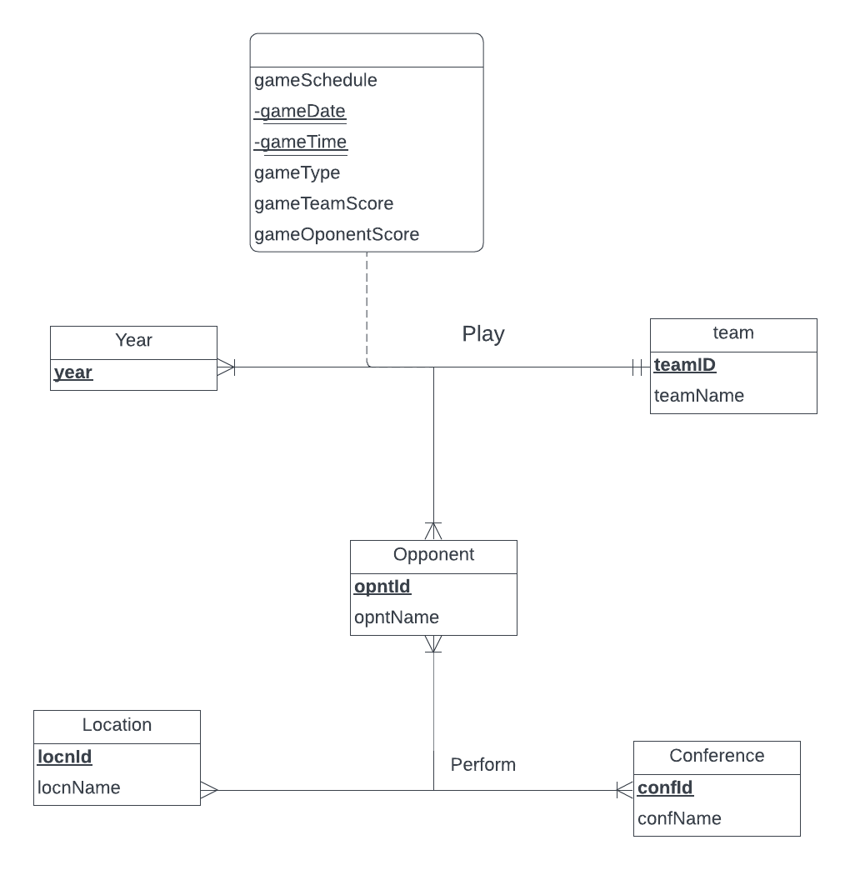
Conceptual Database Design : ER Model
Notes:
<a href="https://storyset.com/people">People illustrations by Storyset</a>

Slide 7
Logical Database Design : Relational Schema
Team (teamId, teamName)
Opponent (opntId, opntName)
Conference (confId, confName)
Year (year)
Location (locnId, locnName)
Perform (opntId, locnId, confId)
Play(teamId, opntId, year, gameDate, gameTime, gameType, gameTeamScore, gameOpponentScore)
Notes:
<a href="https://storyset.com/people">People illustrations by Storyset</a>

Slide 8
Physical Database Design
-- Create Perform table
CREATE TABLE [Game.Perform](
opntId CHAR (5) NOT NULL,
locnId CHAR (5) NOT NULL,
confId CHAR (5) NOT NULL,
CONSTRAINT pk_Perform_opntId_locnId_confId
PRIMARY KEY (opntId, locnId, confId),
CONSTRAINT fk_Perform_opntId FOREIGN KEY (opntId)
REFERENCES [Game.Opponent] (opntId)
ON DELETE NO ACTION ON UPDATE CASCADE,
CONSTRAINT fk_Perform_locnId FOREIGN KEY (locnId)
REFERENCES [Game.Location] (locnId)
ON DELETE NO ACTION ON UPDATE CASCADE,
CONSTRAINT fk_Perform_confId FOREIGN KEY (confId)
REFERENCES [Game.Conference] (confId)
ON DELETE NO ACTION ON UPDATE CASCADE
);
Notes:
<a href="https://storyset.com/people">People illustrations by Storyset</a>

Slide 9
Use Case: Business Transaction #1
What are the win rates for each year?
SELECT
gp.year AS "Year",
FORMAT(SUM(CASE WHEN p.gameTeamScore > p.gameOpponentScore THEN 1 ELSE 0 END) * 100.0 / COUNT(*), 'N2') + '%' AS "Winning Rate"
FROM
[Game.Play] p
JOIN
[Game.Year] gp ON p.year = gp.year
GROUP BY
gp.year
ORDER BY
"Winning Rate" DESC;
Notes:
<a href="https://storyset.com/people">People illustrations by Storyset</a>

Slide 10
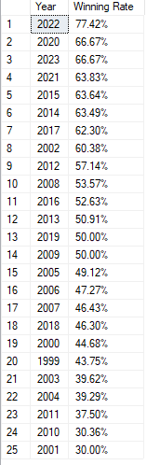
Use Case: Business Transaction #1
What are the win rates for each year?
Notes:
<a href="https://storyset.com/people">People illustrations by Storyset</a>

Slide 11
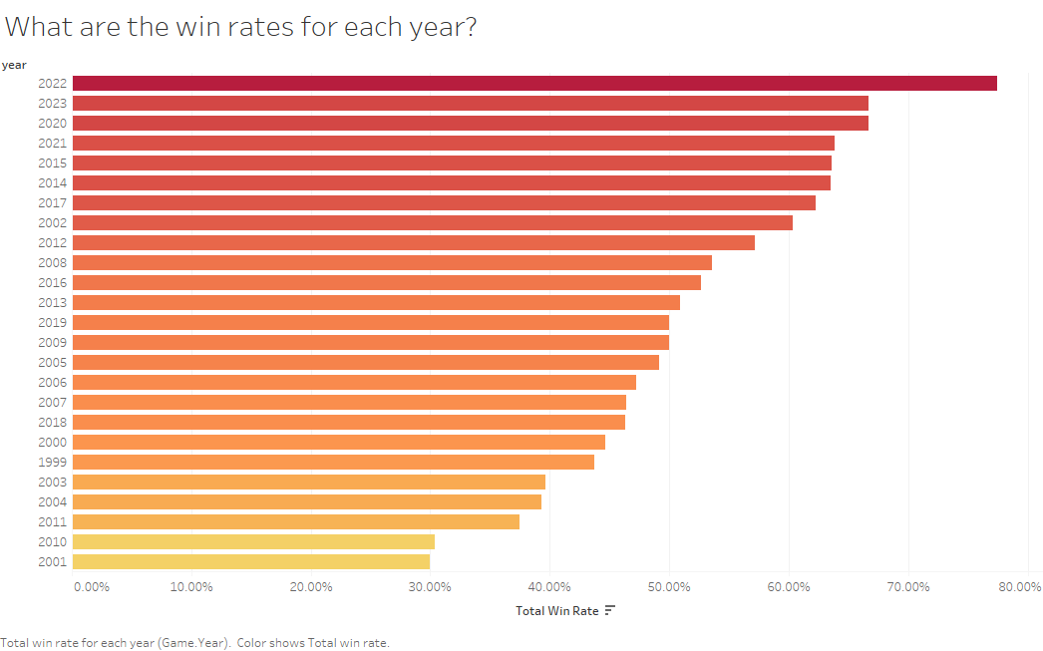
Use Case: Business Transaction #1
Notes:
<a href="https://storyset.com/people">People illustrations by Storyset</a>

Slide 12
Use Case: Business Transaction #2
Among the opponents teams which the Terps have played at least 10 times, who has UMD faced the most?
SELECT
opnt.opntId AS "Opponent ID",
opnt.opntName AS "Opponent Name",
COUNT(*) AS "Total Games Played"
FROM
[Game.Play] p
JOIN
[Game.Opponent] opnt ON p.opntId = opnt.opntId
WHERE
p.gameTeamScore IS NOT NULL
AND p.gameOpponentScore IS NOT NULL
AND p.opntId <> (SELECT teamId FROM [Game.Team] WHERE teamName = 'Maryland')
GROUP BY
opnt.opntId, opnt.opntName
HAVING
COUNT(*) > 10
ORDER BY
"Total Games Played" DESC;
Notes:
<a href="https://storyset.com/people">People illustrations by Storyset</a>

Slide 13
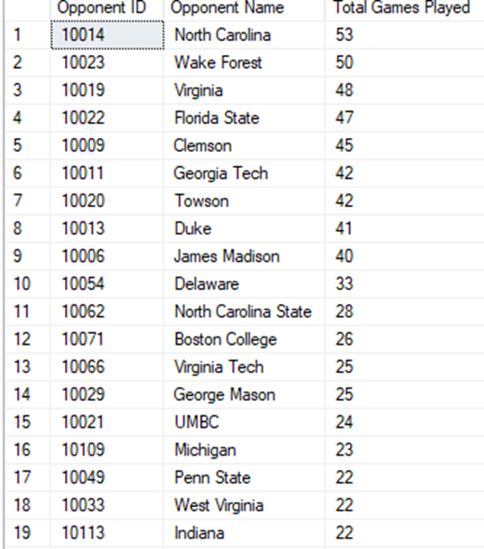
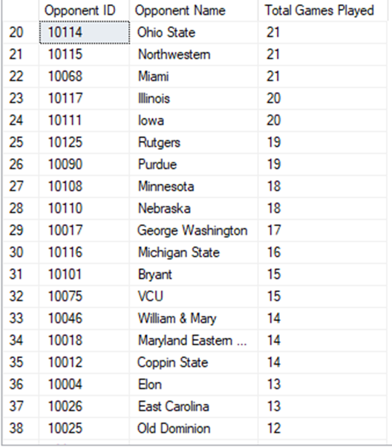
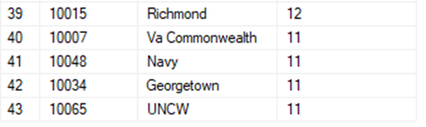
Use Case: Business Transaction #2
Among the opponents teams which the Terps have played at least 10 times, who has UMD faced the most?
Notes:
<a href="https://storyset.com/people">People illustrations by Storyset</a>

Slide 14
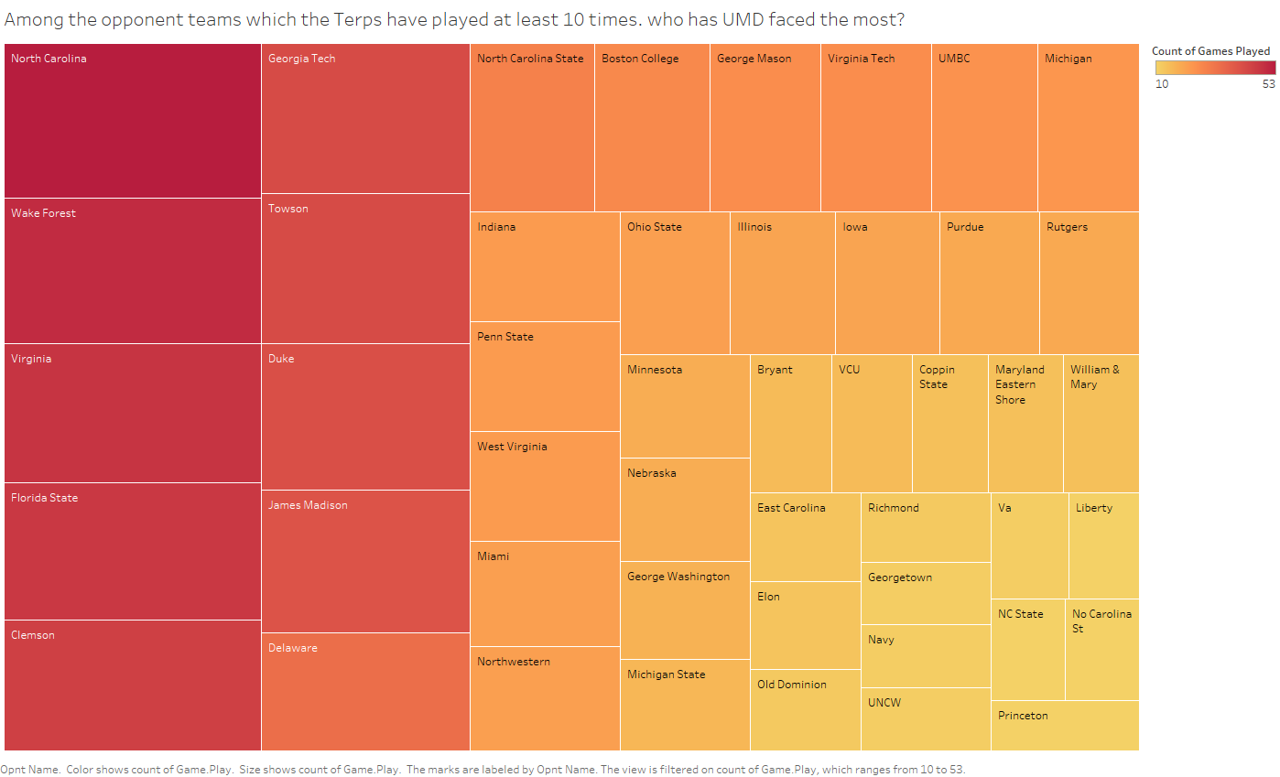
Use Case: Business Transaction #2
Notes:
<a href="https://storyset.com/people">People illustrations by Storyset</a>

Slide 15
Use Case: Business Transaction #3
At which non-home stadium do we have the top 20 win rates? How many games have been played at the respective stadiums?
SELECT
locnId AS "Location ID",
locnName AS "Location Name",
total_wins AS "Total Wins",
"Win Rate",
rnk AS "Rank"
FROM (
SELECT
locnId,
locnName,
total_games,
total_wins,
total_losses,
FORMAT(ROUND(winning_rate, 2), 'N2') + '%' AS "Win Rate",
ROW_NUMBER() OVER (ORDER BY winning_rate DESC) AS rnk
FROM
StadiumRecords
) ranked
WHERE
rnk <=20
ORDER BY
"Win Rate" DESC;
WITH StadiumRecords AS (
SELECT
p.locnId,
l.locnName,
COUNT(*) AS total_games,
SUM(CASE WHEN p.gameTeamScore > p.gameOpponentScore THEN 1 ELSE 0 END) AS total_wins,
COUNT(*) - SUM(CASE WHEN p.gameTeamScore > p.gameOpponentScore THEN 1 ELSE 0 END) AS total_losses,
ROUND(SUM(CASE WHEN p.gameTeamScore > p.gameOpponentScore THEN 1 ELSE 0 END) * 100.0 / COUNT(*), 2) AS winning_rate
FROM
[Game.Play] p
JOIN
[Game.Location] l ON p.locnId = l.locnId
GROUP BY
p.locnId, l.locnName
)
Notes:
<a href="https://storyset.com/people">People illustrations by Storyset</a>

Slide 16
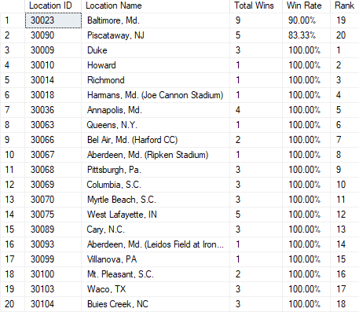
Use Case: Business Transaction #3
At which non-home stadium do we have the top 20 win rates? How many games have been played at the respective stadiums?
Notes:
<a href="https://storyset.com/people">People illustrations by Storyset</a>

Slide 17
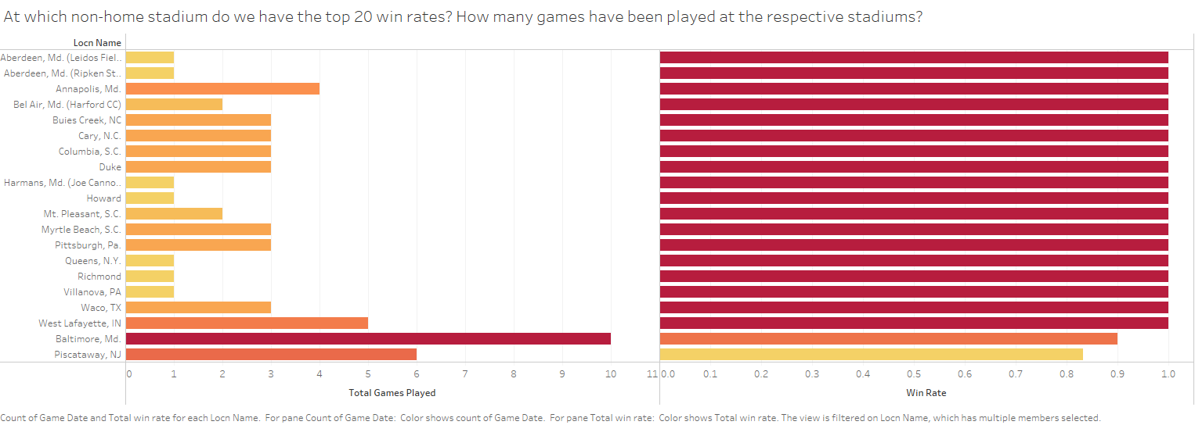
Use Case: Business Transaction #3
Notes:
<a href="https://storyset.com/people">People illustrations by Storyset</a>

Slide 18
Use Case: Business Transaction #4
How does the win rate differ for away, home, and neutral matches in each conference?
SELECT
c.confName AS "Conference Name",
p.gameType AS "Game Type",
COUNT(*) AS "Total Games",
FORMAT(SUM(CASE WHEN p.gameTeamScore > p.gameOpponentScore THEN 1 ELSE 0 END) * 100 / COUNT(*), 'N2') + '%' AS "Winning Rate"
FROM
[Game.Conference] c
JOIN
[Game.Perform] f ON f.confId = c.confId
JOIN
[Game.Play] p ON p.opntId = f.opntId
GROUP BY
c.confName,
p.gameType
Notes:
<a href="https://storyset.com/people">People illustrations by Storyset</a>

Slide 19
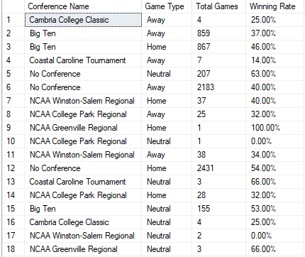
Use Case: Business Transaction #4
How does the win rate differ for away, home, and neutral matches in each conference?
Notes:
<a href="https://storyset.com/people">People illustrations by Storyset</a>

Slide 20
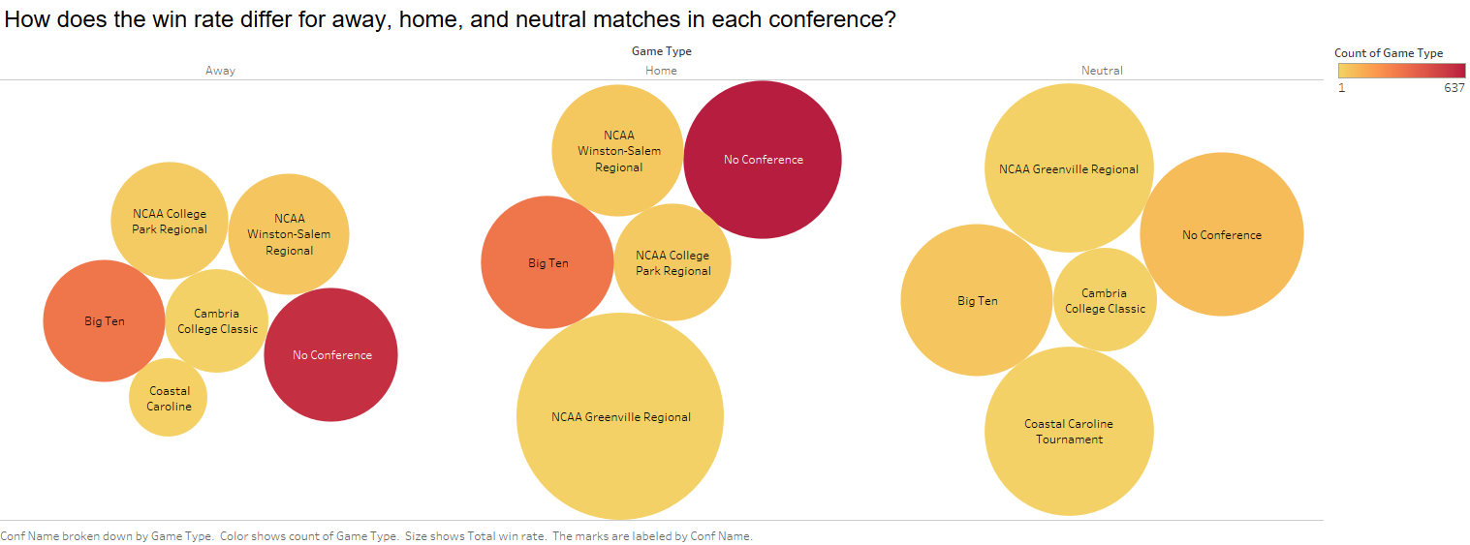
Use Case: Business Transaction #4
Notes:
<a href="https://storyset.com/people">People illustrations by Storyset</a>

Slide 21
Conclusions
The Terps have shown their best performances of the past 25 years between 2020-2023
Keeping up
positive trends
Potential areas of focus
The away performances of the team show a noticeable dip when compared to their home and neutral performances
Neutral ground games have high win rates, especially in the Big Ten conference
Notes:
<a href="https://storyset.com/people">People illustrations by Storyset</a>

